Slide 1
To understand the mining process let us consider the purple box include all possible hashes, since the hash number is 64 character then there are limited number of possible hashes, also, the hash value itself is a hexadecimal number, and if we consider the top of the box is the largest number and the bottom of the box is the smallest value then the hash value will fall somewhere in the box based on its value.

Slide 2
How Mining Works
- ALL POSSIBLE HASHES -
53cf2adfcc2eccc2eb2fc6ce4a4282ee2b42bf70e54eb4c0519e6c4c2617f05c
00000000000000000000da901c5176b10a6d83961dd3c1ac88b59b2dc327aa4
000000000000000000000000000807d9b054d23c473c106c72be9de08b7376c
LARGEST
TARGET
SMALLEST
The dashed line here present the target hash value for miner, the miners need to find a hash value that is smaller than the target number.

Slide 3

How Mining Works
- ALL POSSIBLE HASHES -
53cf2adfcc2eccc2eb2fc6ce4a4282ee2b42bf70e54eb4c0519e6c4c2617f05c
00000000000000000000da901c5176b10a6d83961dd3c1ac88b59b2dc327aa4
000000000000000000000000000807d9b054d23c473c106c72be9de08b7376c
LARGEST
TARGET
SMALLEST
The first two calculated hash numbers are not valid because it is larger than the target line, the third one is a valid hash and will make the miner a winner.

Slide 4
How Mining Works
- ALL POSSIBLE HASHES -
53cf2adfcc2eccc2eb2fc6ce4a4282ee2b42bf70e54eb4c0519e6c4c2617f05c
00000000000000000000da901c5176b10a6d83961dd3c1ac88b59b2dc327aa4
000000000000000000000000000807d9b054d23c473c106c72be9de08b7376c
LARGEST
TARGET
SMALLEST
TIP: Express Target with leading Zeros
E.g. `0000`

Slide 5

How Mining Works
- ALL POSSIBLE HASHES -
Block: #3
Nonce:
23
LARGEST
Data:
John -> Subway 0.001 Bitcoin
Mike -> Microsoft 5 Bitcoin
Sarah -> Joe 70 Bitcoin
Prev.Hash: 3A14DF2E57FB432A
TARGET(`0000’)
Hash: A63AB36162A4F4EE
SMALLEST
TIP: Express Target with leading Zeros
E.g. `0000`

Slide 6
How Mining Works
- ALL POSSIBLE HASHES -
Block: #3
Nonce:
23
LARGEST
Data:
John -> Subway 0.001 Bitcoin
Mike -> Microsoft 5 Bitcoin
Sarah -> Joe 70 Bitcoin
Nonce: 23
Prev.Hash: 3A14DF2E57FB432A
TARGET(`0000’)
Hash: A63AB36162A4F4EE
SMALLEST
TIP: Express Target with leading Zeros
E.g. `0000`

Slide 7
In this example the miner try to find a nonce that will result in a hash below the target line.
Nonce 23 will fail, because the calculated hash is greater than the target line.
The miner will change the nonce value and recalculate the hash.

Slide 8
How Mining Works
- ALL POSSIBLE HASHES -
Block: #3
Nonce 22 will fail too
Nonce:
22
LARGEST
Nonce: 23
Data:
John -> Subway 0.001 Bitcoin
Mike -> Microsoft 5 Bitcoin
Sarah -> Joe 70 Bitcoin
Nonce: 22
Prev.Hash: 3A14DF2E57FB432A
TARGET(`0000’)
Hash: 5665D07FFAAECE46
SMALLEST
TIP: Express Target with leading Zeros
E.g. `0000`

Slide 9
How Mining Works
- ALL POSSIBLE HASHES -
Block: #3
Nonce:
5012
LARGEST
Nonce: 23
Data:
John -> Subway 0.001 Bitcoin
Mike -> Microsoft 5 Bitcoin
Sarah -> Joe 70 Bitcoin
Nonce: 21
Nonce: 22
Nonce: 413
Nonce: 76941
Prev.Hash: 3A14DF2E57FB432A
TARGET(`0000’)
Hash: 000013A1750420BA
SMALLEST
Nonce: 5012
Nonce 5012 win because it leads to a hash value which is below the target line(hash value).
TIP: Express Target with leading Zeros
E.g. `0000`

Slide 10
The miner will win and will be rewarded a bitcoin for his work.
This process is called proof of work.
By finding the correct nonce, the miner proves that he has done the work.

Slide 11

How Mining Works
- ALL POSSIBLE HASHES -
Block: #3
Nonce:
5012
LARGEST
Nonce: 23
Data:
John -> Subway 0.001 Bitcoin
Mike -> Microsoft 5 Bitcoin
Sarah -> Joe 70 Bitcoin
Nonce: 21
Nonce: 22
Nonce: 413
Nonce: 76941
Prev.Hash: 3A14DF2E57FB432A
TARGET(`0000’)
Hash: 000013A1750420BA
SMALLEST
Nonce: 5012
TIP: Express Target with leading Zeros
E.g. `0000`

Slide 12

Consensus Protocol
Distributed P2P Network
Mining
Hash Cryptography
1
2
3
Consensus Protocol
Immutable Ledger

Slide 13
Consensus Protocol
Byzantine Fault Tolerance
A group of army generals formulate a plan for attacking a castle, they will win if the majority of them attack or retreat, otherwise they will lose.
The question now, how to make sure they all attack or retreat?

Slide 14
Byzantine Generals’ Problem
A paper by LESLIE LAMPORT, ROBERT SHOSTAK, and MARSHALL PEASE at Microsoft Research in 1982.
Imagine that several divisions of the Byzantine army are camped outside an enemy city, each division commanded by its own general. The generals can communicate with one another only by messenger. After observing the enemy, they must decide upon a common plan of action. However, some of the generals may be traitors, trying to prevent the loyal generals from reaching an agreement. The generals must decide on when to attack the city, but they need a strong majority of their army to attack at the same time. The generals must have an algorithm to guarantee that (a) all loyal generals decide upon the same plan of action, and (b) a small number of traitors cannot cause the loyal generals to adopt a bad plan. The loyal generals will all do what the algorithm says they should, but the traitors may do anything they wish. The algorithm must guarantee condition (a) regardless of what the traitors do. The loyal generals should not only reach agreement, but should agree upon a reasonable plan.

Slide 15
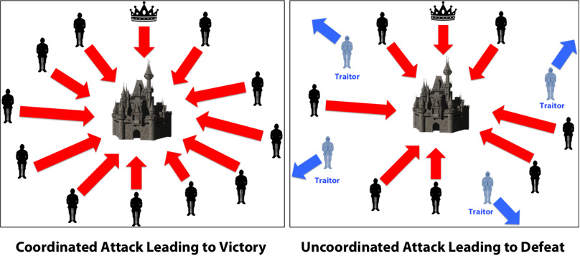

Slide 16
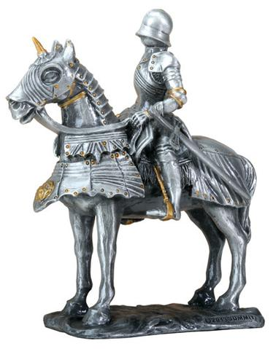
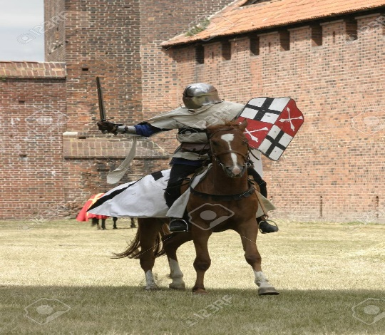

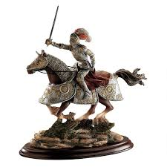

Byzantine Fault Tolerance
Notes:
Images source:
https://ii.designtoscano.com/fcgi-bin/iipsrv.fcgi?FIF=/images/toscano/source/WU69715_1.tif&wid=960=&cvt=jpeg
https://stockagency.panthermedia.net/m/stock-photos/960589/knight-on-a-horse/
https://www.123rf.com/photo_14890161_knight-on-horse-with-weapon-in-hand.html
https://www.google.com/imgres

Slide 17
Basic scenario:
The general with the crown is the commander, the general in the red box is a traitor.
The commander issue an order for the three generals to attack
The generals will relay the message as they received it (except traitor) to other generals.

Slide 18

Byzantine Fault Tolerance
Notes:
Images source:
https://ii.designtoscano.com/fcgi-bin/iipsrv.fcgi?FIF=/images/toscano/source/WU69715_1.tif&wid=960=&cvt=jpeg
https://stockagency.panthermedia.net/m/stock-photos/960589/knight-on-a-horse/
https://www.123rf.com/photo_14890161_knight-on-horse-with-weapon-in-hand.html
https://www.google.com/imgres

Slide 19

Byzantine Fault Tolerance
Notes:
Images source:
https://ii.designtoscano.com/fcgi-bin/iipsrv.fcgi?FIF=/images/toscano/source/WU69715_1.tif&wid=960=&cvt=jpeg
https://stockagency.panthermedia.net/m/stock-photos/960589/knight-on-a-horse/
https://www.123rf.com/photo_14890161_knight-on-horse-with-weapon-in-hand.html
https://www.google.com/imgres

Slide 20
Byzantine Fault Tolerance
The traitor will send the message as retreat (not attack) to the other generals.
Notes:
Images source:
https://ii.designtoscano.com/fcgi-bin/iipsrv.fcgi?FIF=/images/toscano/source/WU69715_1.tif&wid=960=&cvt=jpeg
https://stockagency.panthermedia.net/m/stock-photos/960589/knight-on-a-horse/
https://www.123rf.com/photo_14890161_knight-on-horse-with-weapon-in-hand.html
https://www.google.com/imgres

Slide 21
Byzantine Fault Tolerance
The left bottom general will relay the message as he received it (Attack)
Notes:
Images source:
https://ii.designtoscano.com/fcgi-bin/iipsrv.fcgi?FIF=/images/toscano/source/WU69715_1.tif&wid=960=&cvt=jpeg
https://stockagency.panthermedia.net/m/stock-photos/960589/knight-on-a-horse/
https://www.123rf.com/photo_14890161_knight-on-horse-with-weapon-in-hand.html
https://www.google.com/imgres

Slide 22
Byzantine Fault Tolerance
The right bottom general will relay the message as he received it (Attack)
Notes:
Images source:
https://ii.designtoscano.com/fcgi-bin/iipsrv.fcgi?FIF=/images/toscano/source/WU69715_1.tif&wid=960=&cvt=jpeg
https://stockagency.panthermedia.net/m/stock-photos/960589/knight-on-a-horse/
https://www.123rf.com/photo_14890161_knight-on-horse-with-weapon-in-hand.html
https://www.google.com/imgres

Slide 23

Byzantine Fault Tolerance
The majority of them attacks, so they win the castle.
Notes:
Images source:
https://ii.designtoscano.com/fcgi-bin/iipsrv.fcgi?FIF=/images/toscano/source/WU69715_1.tif&wid=960=&cvt=jpeg
https://stockagency.panthermedia.net/m/stock-photos/960589/knight-on-a-horse/
https://www.123rf.com/photo_14890161_knight-on-horse-with-weapon-in-hand.html
https://www.google.com/imgres

Slide 24
What happen if the commander is a traitor?
The commander will issue an order to attack to two generals and retreat to one general.
Notes:
Images source:
https://ii.designtoscano.com/fcgi-bin/iipsrv.fcgi?FIF=/images/toscano/source/WU69715_1.tif&wid=960=&cvt=jpeg
https://stockagency.panthermedia.net/m/stock-photos/960589/knight-on-a-horse/
https://www.123rf.com/photo_14890161_knight-on-horse-with-weapon-in-hand.html
https://www.google.com/imgres

Slide 25
What happen if the commander is a traitor?
Notes:
Images source:
https://ii.designtoscano.com/fcgi-bin/iipsrv.fcgi?FIF=/images/toscano/source/WU69715_1.tif&wid=960=&cvt=jpeg
https://stockagency.panthermedia.net/m/stock-photos/960589/knight-on-a-horse/
https://www.123rf.com/photo_14890161_knight-on-horse-with-weapon-in-hand.html
https://www.google.com/imgres

Slide 26
The left bottom general will relay the message as he received it (Attack)
The right bottom general will relay the message as he received it (retreat)
The top right general will relay the message as he received it (Attack)
The result is??

Slide 27
What is Byzantine Fault Tolerance (BFT) ?
Is the feature of a distributed network to reach consensus (agreement on the same value) even when some of the nodes in the network fail to respond or respond with incorrect information.
The objective of a BFT mechanism is to safeguard against the system failures by employing collective decision making(both – correct and faulty nodes) which aims to reduce the influence of the faulty nodes.

Slide 28
As we saw when there is on traitor, three generals will attack and as a result they will win the castle.
Now the question is what if there are two traitors, will this algorithm work?? the answer is no.
So in order for this “Byzantine Fault Tolerance” to work no more than 33% of the army generals can be traitors, so the level of tolerance for Byzantine Fault Tolerance is 1/3 or 33%.

Slide 29
As we will see in the next slides, the level of tolerance for blockchain is 51%, this is huge comparing to Byzantine Fault Tolerance.
In other words, in order for an intruder or hacker to hack the blockchain network, he needs to hack into 51% of the nodes, and this is impossible to do especially when the blockchain is distributed over thousands or million of nodes.

Slide 30
For the blockchain consensus protocol we will discuss two challenges:
Challenge 1: Attackers
Challenge 2: Competing Chains

Slide 31

Consensus Protocol
Challenge 1: Attackers

Slide 32
Challenge 1: Attackers
In this challenge the consensus protocol should be able to prevent an attacker from adding malicious block at the end of the Blockchain.
The cryptographic puzzle is hard to solve BUT easy to verify.

Slide 33
Consensus Protocol
Challenge 1: Attackers

Slide 34
Consensus Protocol
Challenge 2:Competing Chains

Slide 35
Consensus Protocol
Challenge 2:Competing Chains

Slide 36
Consensus Protocol
Consensus Protocols
Proof-of-Work (PoW)
Proof-of-Stake (PoS)
Other
There are two major consensus protocols,
Proof of work and proof of stake. The reason it is called PoW because the miners has to do some work in order for them to win the game and get the rewards.

Slide 37
Consensus Protocol
- ALL POSSIBLE HASHES -
Block: #3
Nonce:
5012
LARGEST
Nonce: 23
Data:
John -> Subway 0.001 Bitcoin
Mike -> Microsoft 5 Bitcoin
Sarah -> Joe 70 Bitcoin
Nonce: 21
Nonce: 22
Nonce: 413
Nonce: 76941
Prev.Hash: 3A14DF2E57FB432A
TARGET(`0000’)
Hash: 000013A1750420BA
SMALLEST
Nonce: 5012
This slide emphasizes on the PoW consensus protocol, as we can see the miners work hard to find the correct nonce that leads to the target hash, when the miner find the target hash he gets the reward.
TIP: Express Target with leading Zeros
E.g. `0000`

Slide 38
Consensus Protocol
When a miner mines a new block, he added it to the end of the chain

Slide 39

Consensus Protocol
The miners will receive two rewards for mining a new block,
1. they will get bitcoin reward from the network

Slide 40

Consensus Protocol
2. They receive another reward which is the fees associated with the transactions included in the mined block.
If the new block is malicious then the miner will lose all the rewards, so there is an incentive for the miner to play fair and only add legitimate blocks.

Slide 41

Consensus Protocol
Also, before the new block get added to other nodes, each node do a list of security checks before accepting the new mined block, If they find out the new block is malicious then they reject it and the miner will not be rewarded.

Slide 42
Challenge 2:Competing Chains
The Competing Chains challenge happen when two miners mine the same block at the same time.
Here two miners added a new block at the same time, the orange block and the purple block, the consensus protocol should be able to prevent the Blockchain network from creating two different chains, the consensus protocol will solve this challenge.

Slide 43
Consensus Protocol
Challenge 2:Competing Chains
The Competing Chains challenge happen when two miners mine the same block at the same time.

Slide 44
Consensus Protocol
Here two miners mined a new block at the same time, the orange block and the purple block, the consensus protocol should be able to prevent the Blockchain network from creating two different chains.

Slide 45
Consensus Protocol
Depending on the network speed and traffic, the orange block start propagating through out the network, same thing happen to the purple block.

Slide 46
Consensus Protocol

Slide 47
Consensus Protocol
Depending on the network speed and network traffic, the orange block propagated faster than the purple block. Now, four nodes have a Blockchain with the orange block, and two nodes have Blockchain with purple block.

Slide 48
Consensus Protocol

Slide 49
Consensus Protocol

Slide 50
Consensus Protocol
Notes:
More orange blocks added

Slide 51
Consensus Protocol

Slide 52
The consensus protocol will keep the longer chain and will remove the shorter chain.
The orange chain is loner and will stay and the purple blocks will become an orphan blocks, and replaced with the orange ones.
The only miner who mined the orange block will get rewarded.

Slide 53
Consensus Protocol

Slide 54
Consensus Protocol

Slide 55
Consensus Protocol
Orphaned
Block

Slide 56
Consensus Protocol

Slide 57
Nonce for a valid hash value
https://tools.superdatascience.com/blockchain/block

Slide 58
Success cases in Blockchain
Supply Chain Managemnt
https://www.coindesk.com/walmart-will-start-tracking-groceries-on-blockchain-in-2019/
Humanitarian aid
https://www.coindesk.com/united-nations-sends-aid-to-10000-syrian-refugees-using-ethereum-blockchain/
Real Estate
Insurance
Cryptocurrency

